Slide 2
What is Gaisce?

Slide 3
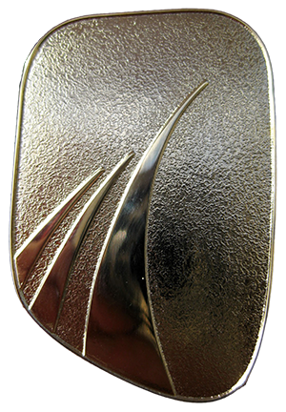
What organisations offer the Gaisce Award to young people?
Schools
Youth Services
Youth Clubs
Disability Services
Scouts & Guides
Sports Clubs
And many more . . .

Slide 4
What's Involved?
3 Award Levels:
Bronze
Silver
Gold
Participants choose activities in 3 areas:
Personal Skill
Physical Recreation
Community Involvement
+ Adventure Journey

Slide 5
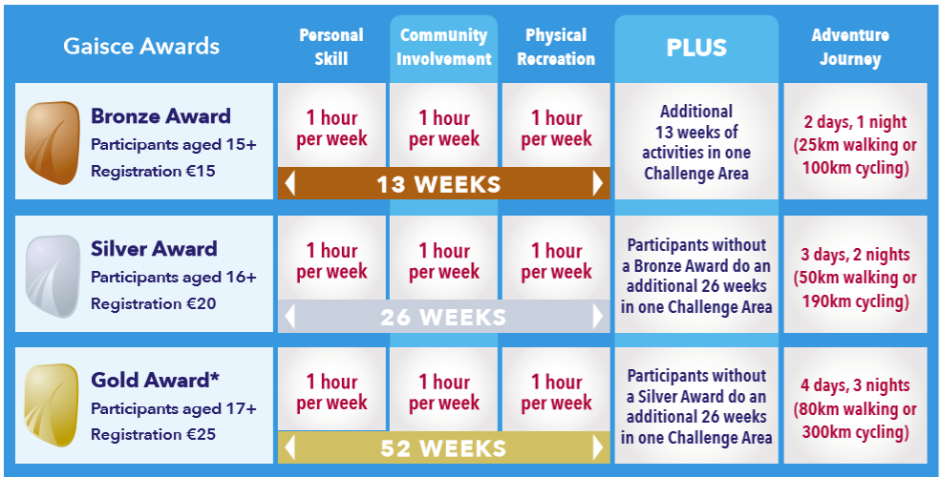

Slide 6
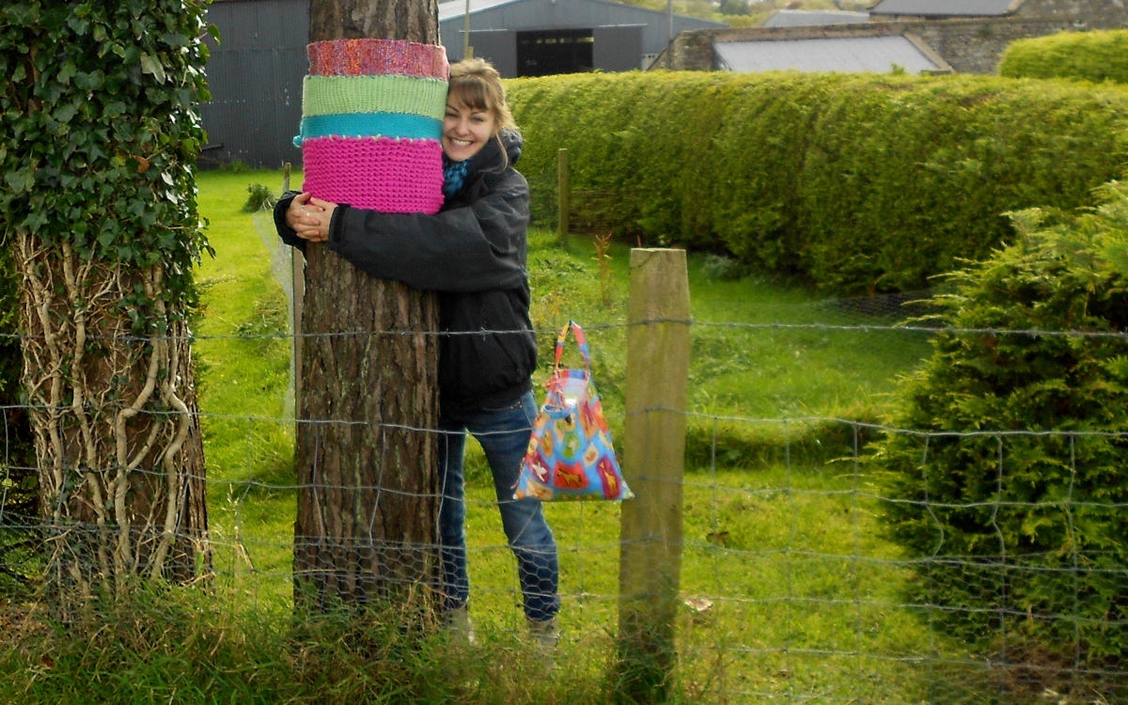
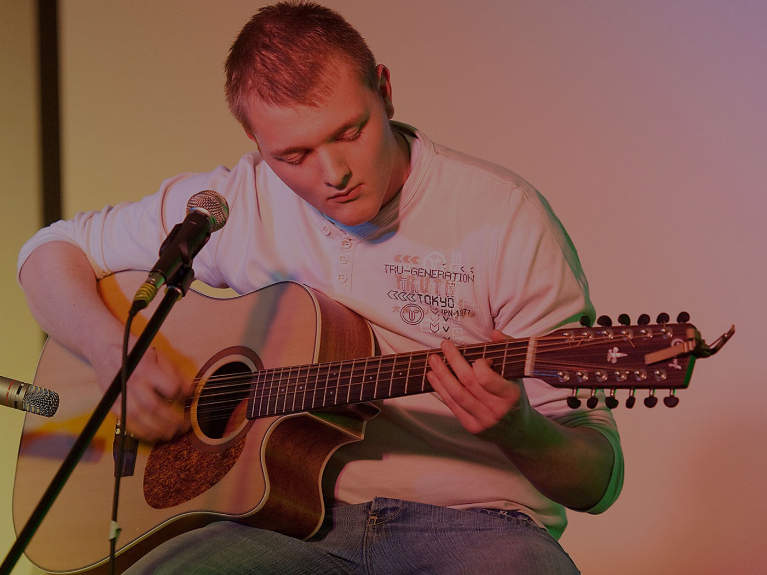
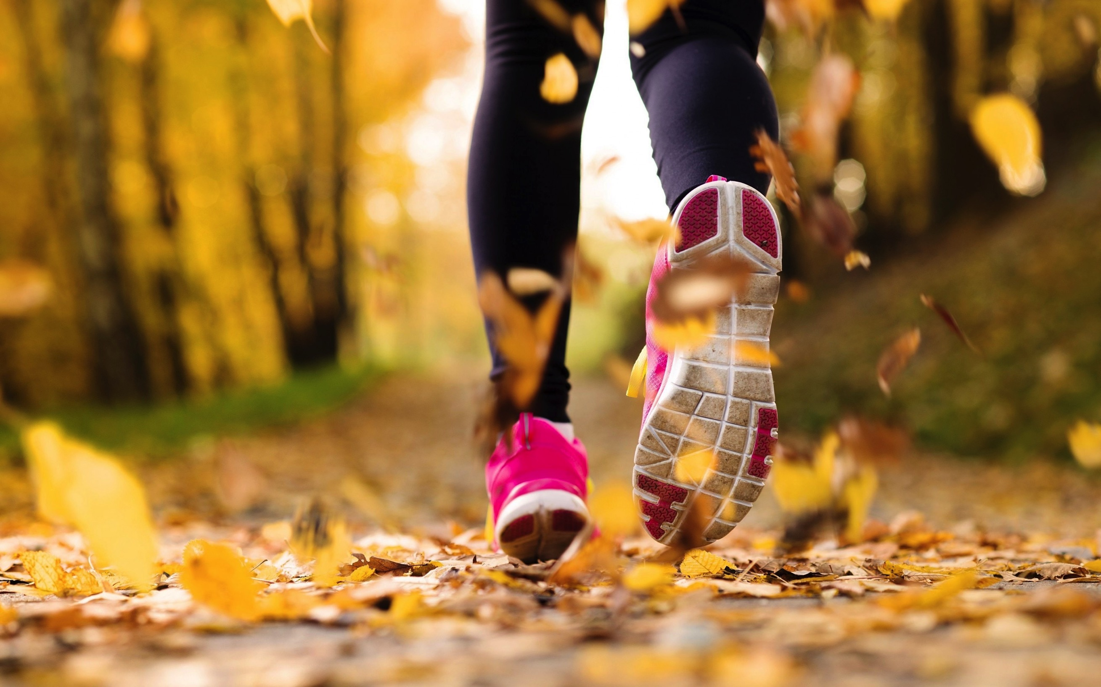
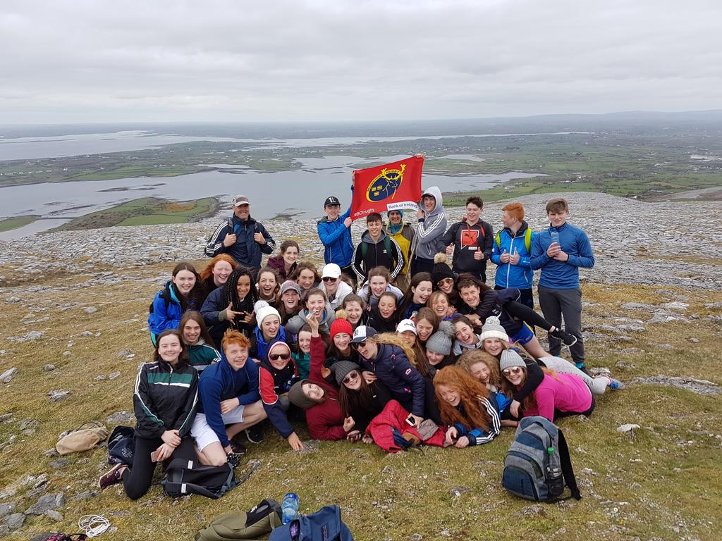
Community
Involvement
1 hour per week
Personal Skill
1 hour per week
Physical Recreation
1 hour per week
Adventure Journey
2 days, 1 night (Bronze)

Slide 7
Community Involvement
Charity Shop
Tidy Towns / Green flags
Coaching younger people
Set up a club / society / committee

Slide 8
Personal Skill
Arts & Crafts
Cooking / Baking
Computer / IT
Learning an Instrument
Singing
Learn a language
Counselling

Slide 9
Physical Recreation
Running – Couch to 5km
Cycling
Swimming
Team sports
Gym
Yoga
Horse riding
Kayaking

Slide 10
Adventure Journey
Bronze – 2 days, 1 night – 25km
Silver – 3 days, 2 nights – 50km
Gold – 4 days, 3 nights – 80km
A 4 night, 5 day Residential Project is also required for Gold Participants.

Slide 11
Key Questions for Participants
What do you want to do in each challenge area?
Will it last the required number of weeks?
Who will vouch for you / sign off?
Which challenge area will you choose for your additional time?

Slide 12
www.gaisce.ie
Select County: DUBLIN SOUTH COUNTY
Award Partner: Loreto Abbey
PAL: Marie Lonergan/Jennifer Hannigan

Slide 13
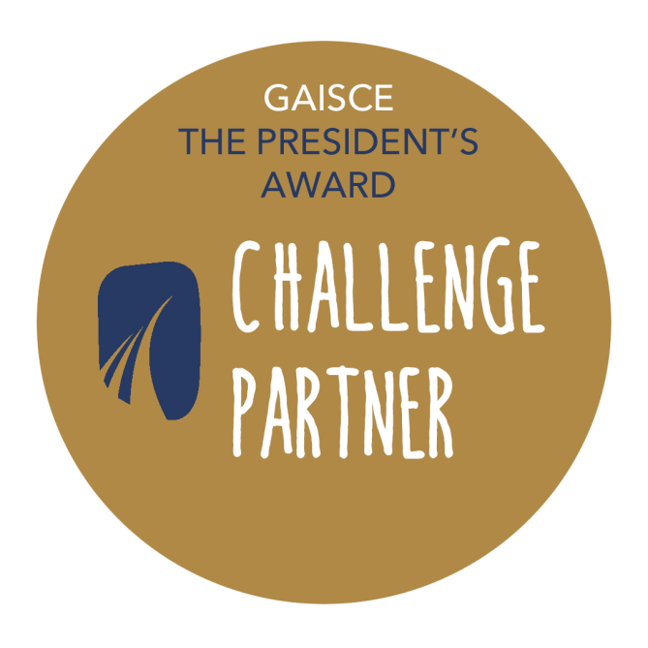

Slide 14
Ger Brady- ger@Gaisce.ie

